Slide 1
Appendix 1: Chipotle
Proposed Recommendations

Slide 2
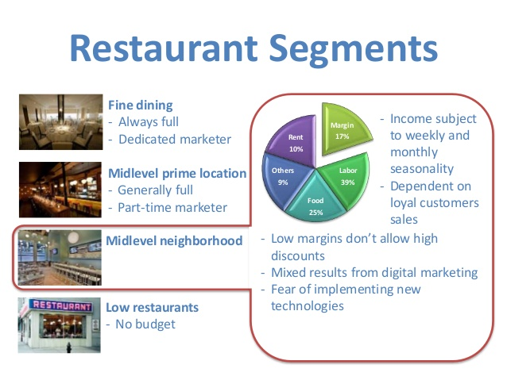
Recommended Targeting and Promotion strategy
Notes:
Chipotle has been using segmentation as the targeting strategy for its market. In particular, the company has been focused on a focused differentiation strategy that ensures that the company has gained new customers in the marketplace. This will improve the reach that the company has in terms of its ability to gain new customers for the market. As a result, most of the companies have been promoting their products using social media with an aim of getting more people to subscribe to their loyalty programs.

Slide 3
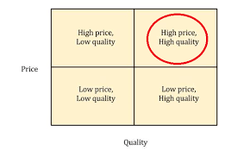
Price as marketing positioning
Notes:
The current marketing positioning is based on price. Chipotle has positioned itself as a company that provides its customers with products that have the cheapest prices. This positioning strategy is efficient as it helps the company to achieve massive success over time. The positioning that the company has helped to achieve increased loyalty and growth over time. Chipotle needs to use a combination of different pricing strategies based on competition and shifts in demand. This will lead to changes in market performance that will have a great impact in terms of how the company performs against competition. In the next year, Chipotle pricing model needs to be based on competition, strategy and industry. This will provide the company with the best idea in terms of enhancing its performance and achievement of growth over time. This is one of the strategies that will contribute to a rise of growth in terms of performance and encourage market dominance.

Slide 4
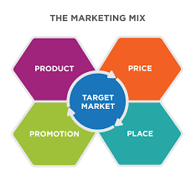
Chipotle Marketing Mix
Notes:
Chipotle marketing mix strategy entails the incorporation of the price, promotion, place and product strategies. The incorporation of these strategies will help the company to achieve success over time. Company will always provide its customers and potential customers with products for them to try. These may even include householder products. The companies can also provide store promotions with an aim of promoting such products. In the next financial year, Chipotle management the company can employ in the marketplace is the end cap marketing and point of sale promotions. These are ways of ensuring that a product has been promoted to the financial consumers to ensure that it has moved quickly. The accessible products are always provided to the financial consumers to ensure that they have created a positive impression in the marketplace

Slide 5
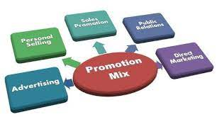
Recommended Promotional Mix
Notes:
Most of the promotional strategies are similar to those of the competitors. Chipotle uses seasonal and themed promotions that are aimed at attracting customers. In the next financial year the company needs to change the promotional strategies into direct promotions and partnership promotions so as to differentiate itself. An effective promotion strategy by Chipotle should be aimed at increasing the value, the needs and attaching to the emotions of the locals especially when it comes to the purchasing decisions. This will help to increase market share and dominance for the purchase of products

Slide 6
References
Mladjenovic, P. J. (2016). High-level investing for dummies. Hoboken, NJ: For Dummies
Schoenebeck, K. P., & Holtzman, M. P. (2012). Interpreting and analyzing financial statements. Upper Saddle River, N.J: Prentice Hall.
Malhotra, N. K. (2008). Review of Marketing Research, 5. Armonk: Emerald Group Publishing Limited.
Iacobucci, D. (2017). Marketing Management. Mason, OH: Cengage.
Churchill, G. A. (2020). Basic Marketing research. Fort Worth: Dryden Press.

